Slide 1
Headline
Photo: Lisa Beller
Subheading

Slide 2
Headline
Photo: Lisa Beller
Subheading

Slide 3
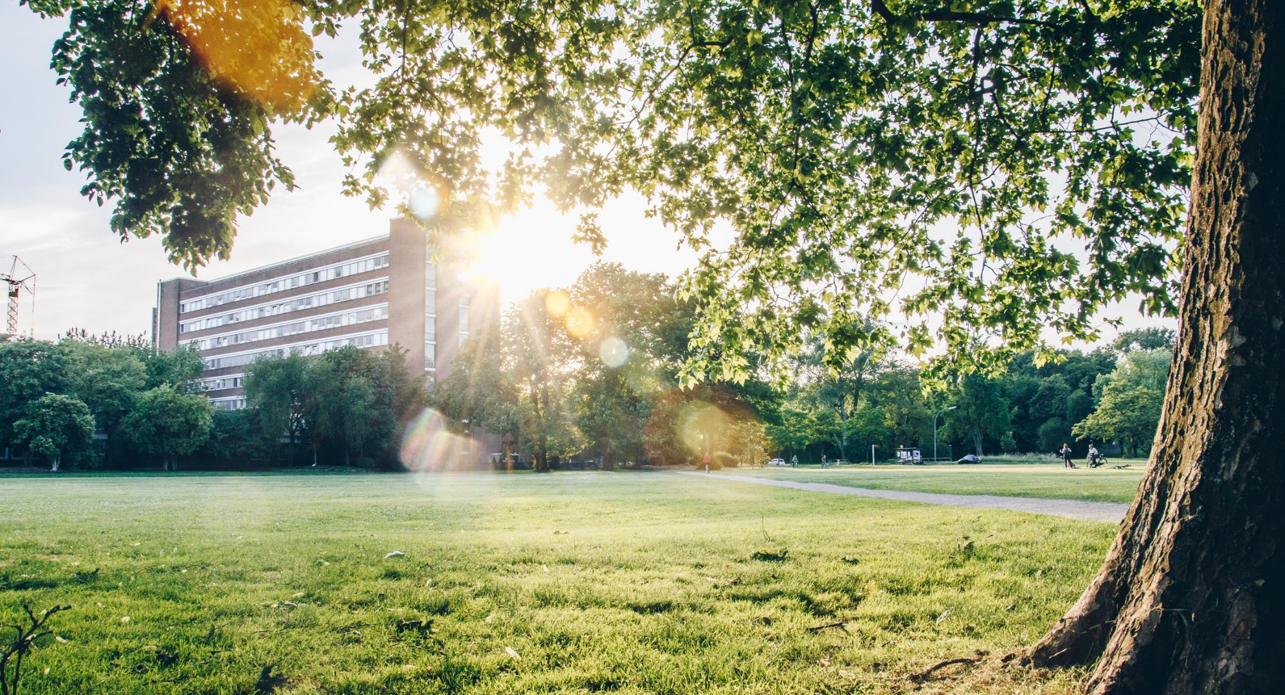
Headline
Photo: Jörn Henn
Subheading

Slide 4
HEadline
Subheading
4

Slide 5
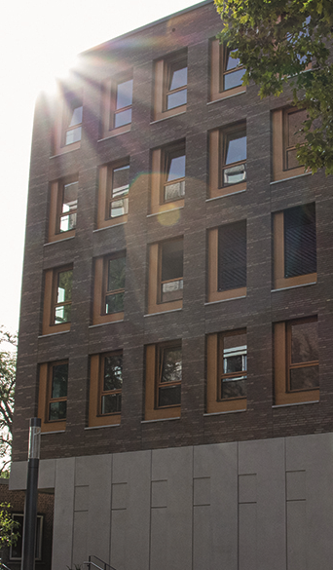
Heritage
Photo: L. Hoffmann
97
Founded in 1901 as a School of Commerce, we have extended our scope to Economics, Sociology, and Politics and have now over a century experience in the education of new generations of business professionals, economists, sociologists, and political experts.
Professors
7
Bachelor‘s programmes
15
Master‘s programmes

Slide 6
Our Vision
To be among the leading academic institutions in Management, Economics, and Social Sciences in Europe, measured in terms of
quality and visibility of our research in selected fields,
education and preparation of open-minded students for future careers, and
the impact that our activities have on people, organisations, society, and the planet.

Slide 7
„Today’s ideas.
Tomorrow’s impact.“
Our Claim

Slide 8
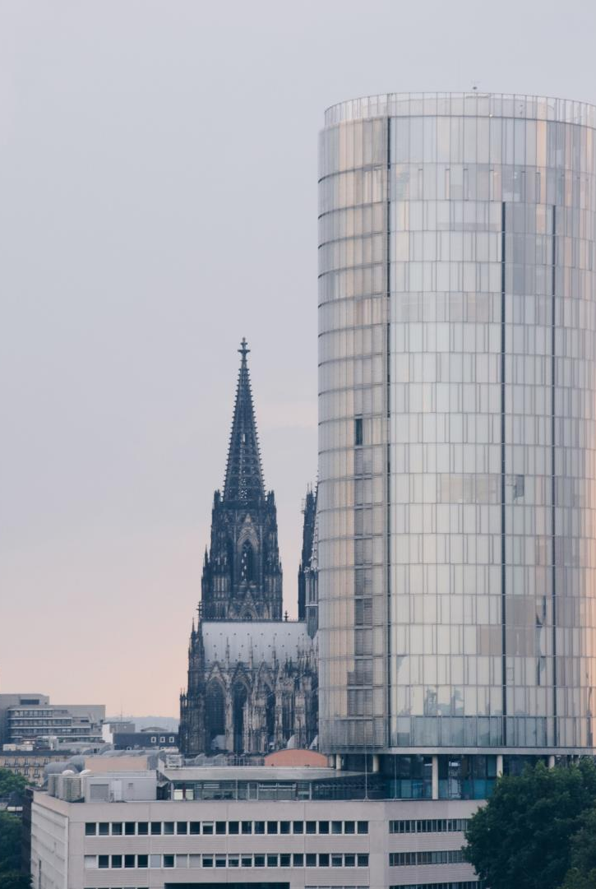
Great Location
Photo: Jörn Henn
With one million citizens (10 % of them students) and a lively start-up culture, Cologne is the economic and scientific centre of the Rhineland region.
Cologne is also proud of its reputation as a vibrant and tolerant city that is simultaneously multicultural – with 18% non-German residents – and strong in its local identity.
“Karneval”, Cologne’s famous carnival season taking place every February, and the popular local beer “Kölsch”, brewed exclusively in Cologne, are only two examples of the vivid cultivation of the city’s traditions.

Slide 9
Our Values
Photo: Gregor Hübl
Plurality
We value academic freedom, including open discussions of opposing views
We value independent thinking
We strive for diverse and international faculty, staff and students
We value multi-disciplinary research
We value international cooperation within networks of academic institution
Authenticity
We value our academic heritage as a multidisciplinary Faculty
We value our local heritage of Cologne as a 2000-year-old multicultural city at the crossroads of trade flows
We value Cologne's spirit of ‘Lebensfreude’
We are honest with each other and present our authentic selves
We value curiosity, creativity and entrepreneurial spirit
Responsibility
We strive for excellence in research, teaching, outreach and administration
We strive for rigor and relevance in research
We strive for impact and are pragmatic
We feel responsible for contributing to a sustainable world
We adhere to high ethical standards
Togetherness
We value our WiSo-Faculty as a community
We work together to achieve our WiSo goals and respect broadly supported decisions
We value all stakeholders and consider their interests
We strive for a sense of belonging and interact in a respectful and friendly manner
We value collegiality and collaboration

Slide 10
I am a headline
I am a key point and offer exciting and important information
I am another key point and am very interesting and informative
31 MAR | Event / Deadline A WiSo Building // Room 201
30 APR | Event / Deadline B WiSo Building // Room 201
15 JUN | Event / Deadline C WiSo- Building // Room 201

Slide 11
In case of further questions please contact
AFFILIATION
Carla Agrippina Colonia
+49 221 470 1393
MO - FR 9 - 10 am
E-mail@wiso.uni-koeln.de

